Slide 1


Descriptive and Analytical

Slide 2
MCQ -1
1.Migration study is used to study:
a. Sociodemographic reasons for migration of a population
b. Prevalence of disease in a population
c. Environmental & genetic factors in a disease in population
d. Diseases with long Incubation period

Slide 3
MCQ -2
2.Descriptive Epidemiology includes all except
a. Retrospective and Prospective study
b. Disease
c. Time
d. Place

Slide 4
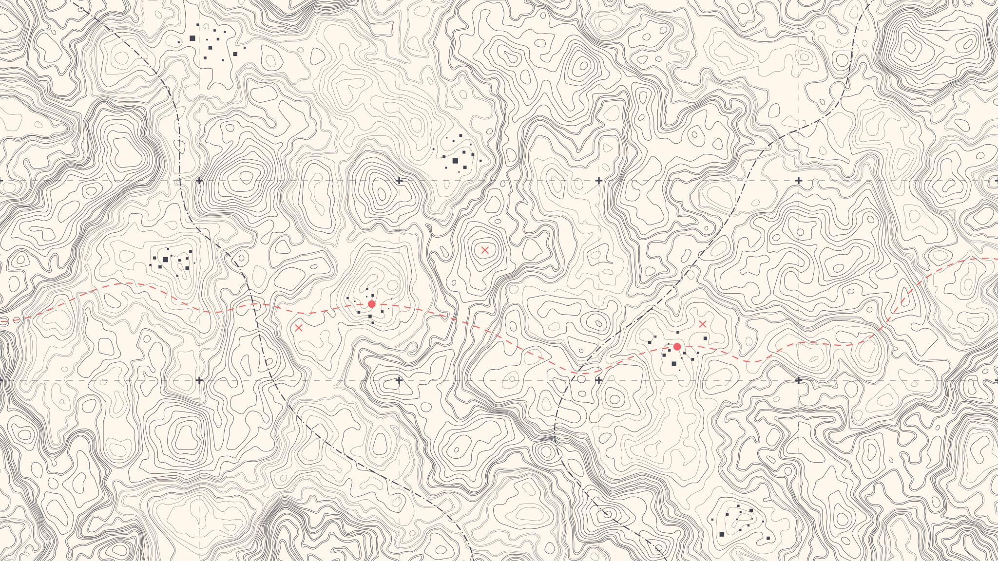
MCQ - 3
3. A spot map is particularly useful for displaying:
a. Geographic location of exposure of each case
b. Incidence rate of disease by area
c. Prevalence rate of disease by area
d. Mortality rate of a disease

Slide 5
MCQ - 4
4. Secular Trend refers to:
a. Long term changes
b. Short term changes
c. Seasonal changes
d. Periodical changes

Slide 6
MCQ - 5
5. Father of Public health?
a. Louis Pasteur
b. Cholera
c. John Snow
d. Robert Koch

Slide 7
Steps
1. Defining the population to be studied
2. Defining the disease under study
3. Describing the disease by
a. time
b. place
c. person
4. Measurement of disease
5. Comparing with known indices
6. Formulation of an aetiological hypothesis

Slide 8

Measurement of disease
Available in terms of mortality, morbidity, disability, etc
Should be available for different subgroups
Morbidity has two aspects - incidence and prevalence
Incidence - “longitudinal” studies
Prevalence - “cross-sectional” studies.

Slide 9
Cross-sectional studies
Simplest form of an observational study.
It is based on a single examination of a cross-section of population at one point in time
Results of which can be projected on the whole population provided the sampling has been done correctly.
Cross-sectional study is also known as “prevalence study”.

Slide 10
Cross-sectional studies
More useful for chronic than short-lived diseases.
In a study of hypertension, we can also collect data during the survey about age, sex, physical exercise, body weight, salt intake and other variables of interest.
We can determine how prevention of hypertension is related to certain variables simultaneously measured.
Study tells us about the distribution of a disease in population rather than its aetiology.

Slide 11
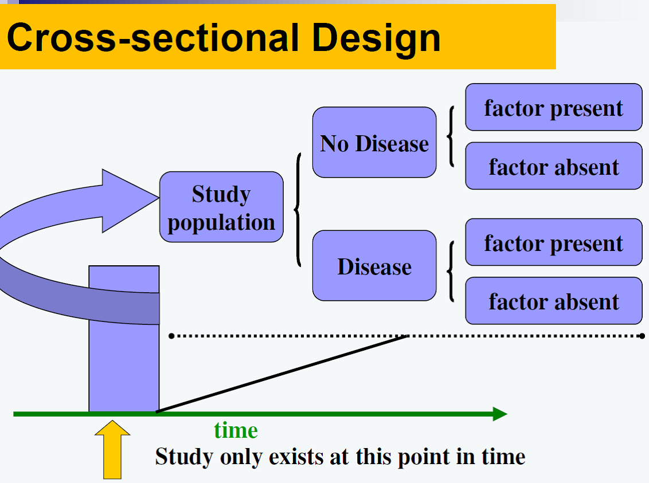
Limitations
Cannot establish causality
Selection bias
Information Bias
Measurement bias
Length biased sampling
Cases over-represented if illness has long duration,
Underrepresented if illness had short duration
Recall Bias
Information about the natural history of disease or about the rate of occurrence of new cases

Slide 12
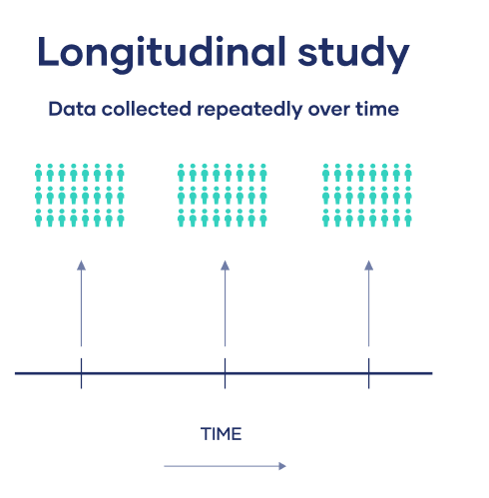
Longitudinal studies
Observations are repeated in the same population over a prolonged period of time by means of follow-up examinations.
Cross-sectional studies - photograph, longitudinal studies - cine film.
Study the natural history of disease and its future outcome

Slide 13
Longitudinal studies
For identifying risk factors of disease,
For finding out incidence rale or rate of occurrence of new cases of disease in the community.
Longitudinal studies are difficult to organize and more time-consuming than cross-sectional studies.
Measurement can also be extended to health states and events.

Slide 14

Comparing known indices
The essence of epidemiology is to make comparisons and ask questions.
By making comparisons between different populations, and subgroups of the same population, it is possible to arrive at clues to disease aetiology.
We can also identify or define groups which are at increased risk for certain diseases.

Slide 15
Formulation of a hypothesis
A hypothesis is a supposition, arrived at from observation or reflection.
It can be accepted or rejected, using the techniques of analytical epidemiology.
An epidemiological hypothesis should specify the following:
The population - the characteristics of the persons to whom the hypothesis applies
The specific cause being considered
The expected outcome - the disease
The dose-response relationship - the amount of the cause needed to lead to a stated incidence of the effect
The time-response relationship - the time period that will elapse between exposure to the cause and observation of the effect.

Slide 16
Research question
Population / Patient
P
Intervention / exposure
I
Comparison
C
Outcome
O
Time
T
Setting
S

Slide 17
Uses of descriptive epidemiology
Provide data regarding the magnitude of the disease load and types of disease problems in the community in terms of morbidity and mortality rates and ratios
Provide clues to disease aetiology, and help in the formulation of an aetiological hypothesis.
Existence of a possible causal association between a factor and a disease is usually recognized in descriptive studies. Thus, if the disease is observed to be more frequent in a particular group than in others, hypotheses are formulated to explain the increased frequency.
Provide background data for planning, organizing and evaluating preventive and curative services,
They contribute to research by describing variations in disease occurrence by time, place and person,

Slide 18
Analytical Epidemiology
In contrast to descriptive studies that look at entire populations, in analytical studies, the subject of interest is the individual within the population.
The objective is not to formulate, but to test hypotheses.
Although individuals are evaluated in analytical studies, the inference is not to individuals, but to the population from which they are selected.

Slide 19
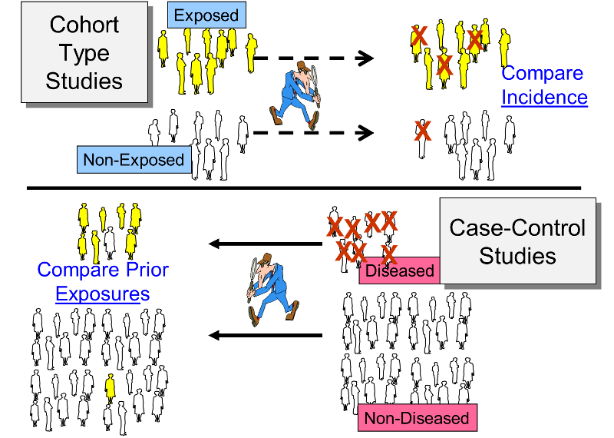
Types
Case – control Study
Cohort Study
Determine
Whether or not a statistical association exists between a disease and a suspected factor
The strength of the Association.

Slide 20
Introduction
Common first approach to test causal hypothesis
Aka Retrospective studies
Features
Both exposure and outcome (disease) have occurred before the start of the study
The study proceeds backwards from effect to cause
It uses a control or comparison group to support or refute an inference.
In case control studies, the unit is the individual rather than the group.
The focus Is on a disease or some other health problem that has already developed.

Slide 21
Cases & Controls
Cases and controls must be comparable with respect to known “confounding factors” such as age, sex, occupation, social status, etc.
The questions asked relate to personal characteristics and antecedent exposures which may be responsible for the condition studied.
Example - one can use as “cases” the immunized children and use as “controls” un-immunized children and look for factors of interest in their past histories.

Slide 22
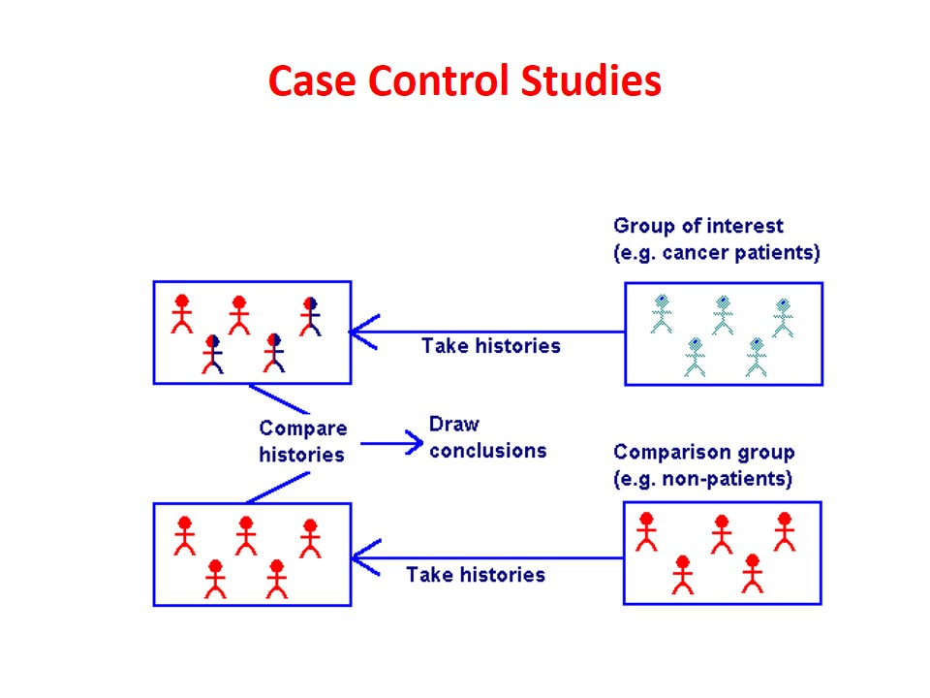
Basic design
Suspected / Risk factors | Cases | Control
Present | a | b
Absent | c | d

Slide 23
Basic steps
Selection of cases and controls
Matching
Measurement of exposure
Analysis and interpretation.

Slide 24
Selection of cases
Definition of a case : The prior definition of what constitutes a “case” is crucial
DIAGNOSTIC CRITERIA : The diagnostic criteria of the disease and the stage of disease, if any (e.g., breast cancer Stage I) to be included in the study must be specified before the study is undertaken.
ELIGIBILITY CRITERIA : A criterion customarily employed is the requirement that only newly diagnosed (incident) cases within a specified period of time are eligible than old cases or cases in advanced stages of the disease (prevalent cases).

Slide 25
Sources of cases
HOSPITALS : It is often convenient to select cases from hospitals. The cases may be drawn from a single hospital or a network of hospitals, admitted during a specified period of time.
The entire case series or a random sample of it is selected for study,
GENERAL POPULATION : In a population-based case control study, all cases of the study disease occurring within a defined geographic area during a specified period of time are ascertained, often through a survey, a disease registry or hospital network. The entire case series or a random sample of it is selected for study. The cases should be fairly representative of all cases in the community.
Cohort – Nested cases control study

Slide 26
Selection of controls
The controls must be free from the disease under study.
They must be as similar to the cases as possible, except for the absence of the disease under study.
As a rule, a comparison group is identified before a study is done, comprising of persons who have not been exposed to the disease or some other factor whose influence is being studied.
Difficulties may arise in the selection of controls if the disease under investigation occurs in subclinical forms whose diagnosis is difficult.

Slide 27
Sources of Control
HOSPITAL CONTROLS: The controls may be selected from the same hospital as the cases, but with different illneses other than the study disease.
Usually it is unwise to choose a control group from a group of patients with one disease. This is because hospital controls are often a source of “selection bias”.
Many hospital patients may have diseases which are also influenced by the factor under study. For example, if one was studying the relationship of smoking and myocardial infarction and chooses bladder cancer cases as controls, the relationship between smoking and myocardial infarction may not have been demonstrated.
Care must be taken when using other patients as comparison subjects, for they differ in many ways from a normal healthy population.
Ideally the controls should have undergone the same diagnostic work-up as cases, but have been found to be negative. But this may not be acceptable to most controls

Slide 28
Sources of Control
RELATIVES : The controls may also be taken up from relatives (spouses and siblings).
Sibling controls are unsuitable where genetic conditions are under study.
NEIGHBOURHOOD CONTROLS : The controls may be drawn from persons living in the same locality as cases, persons working in the same factory or children attending the same school.
GENERAL POPULATION : Population controls can be obtained from defined geographic areas, by taking a random sample of individuals free of the study disease.
We must use great care in the selection of controls to be certain that they accurately reflect the population that is free of the disease of interest.

Slide 29

Thanks

